Slide 1

CLOUD & SERVERLESS COMPUTING
PROJECT TITLE :
Using Amazon S3 Object Lambda to Dynamically Watermark Images as They Are Retrieved
Marri Nehakrishna
2000030612

Slide 2
OVERVIEW
With Amazon S3 Object Lambda, you can add your own code to S3 GET, HEAD, and LIST requests to modify data as it is returned to an application. You can use custom code to modify the data returned by S3 GET requests to convert data formats (for example, XML to JSON), dynamically resize images, redact confidential data, and much more. You can also use S3 Object Lambda to modify the output of S3 LIST requests to create a custom view of objects in a bucket, and S3 HEAD requests to modify object metadata like object name and size.
The purpose of this tutorial is to show you how to get started with Amazon S3 Object Lambda. Many organizations store images in Amazon S3 that are accessed by different applications, each with unique data format requirements. In certain cases, images may need to be modified to include a watermark depending on the user accessing the image (for example, a paying subscriber can view images without watermarks, while a non-paying user receives a watermarked image).
In this tutorial, we will use S3 Object Lambda to add a watermark to an image as it is retrieved from Amazon S3. S3 Object Lambda can be used to modify data as it is retrieved from Amazon S3, without changing the existing object or maintaining multiple derivative copies of the data. By presenting multiple views of the same data and removing the need to store derivative copies, you can save on storage costs.

Slide 3
What you will accomplish
Create an Amazon S3 bucket
Create an S3 Access Point
Create an AWS Lambda function to modify images
Create an S3 Object Lambda Access Point

Slide 4
Prerequisites
To complete this tutorial, you need an AWS account. Access this support page for more information on how to create and activate a new AWS account.
You can create an IAM user for the tutorial, or you can add permissions to an existing IAM user. To complete this tutorial, your IAM user must include the following permissions to access relevant AWS resources and perform specific actions:
s3:CreateBucket
s3:PutObject
s3:GetObject
s3:ListBucket
s3:CreateAccessPoint
s3:CreateAccessPointForObjectLambda
s3-object-lambda:WriteGetObjectResponse
lambda:CreateFunction
lambda:InvokeFunction
iam:AttachRolePolicy
iam:CreateRole
iam:PutRolePolicy

Slide 5
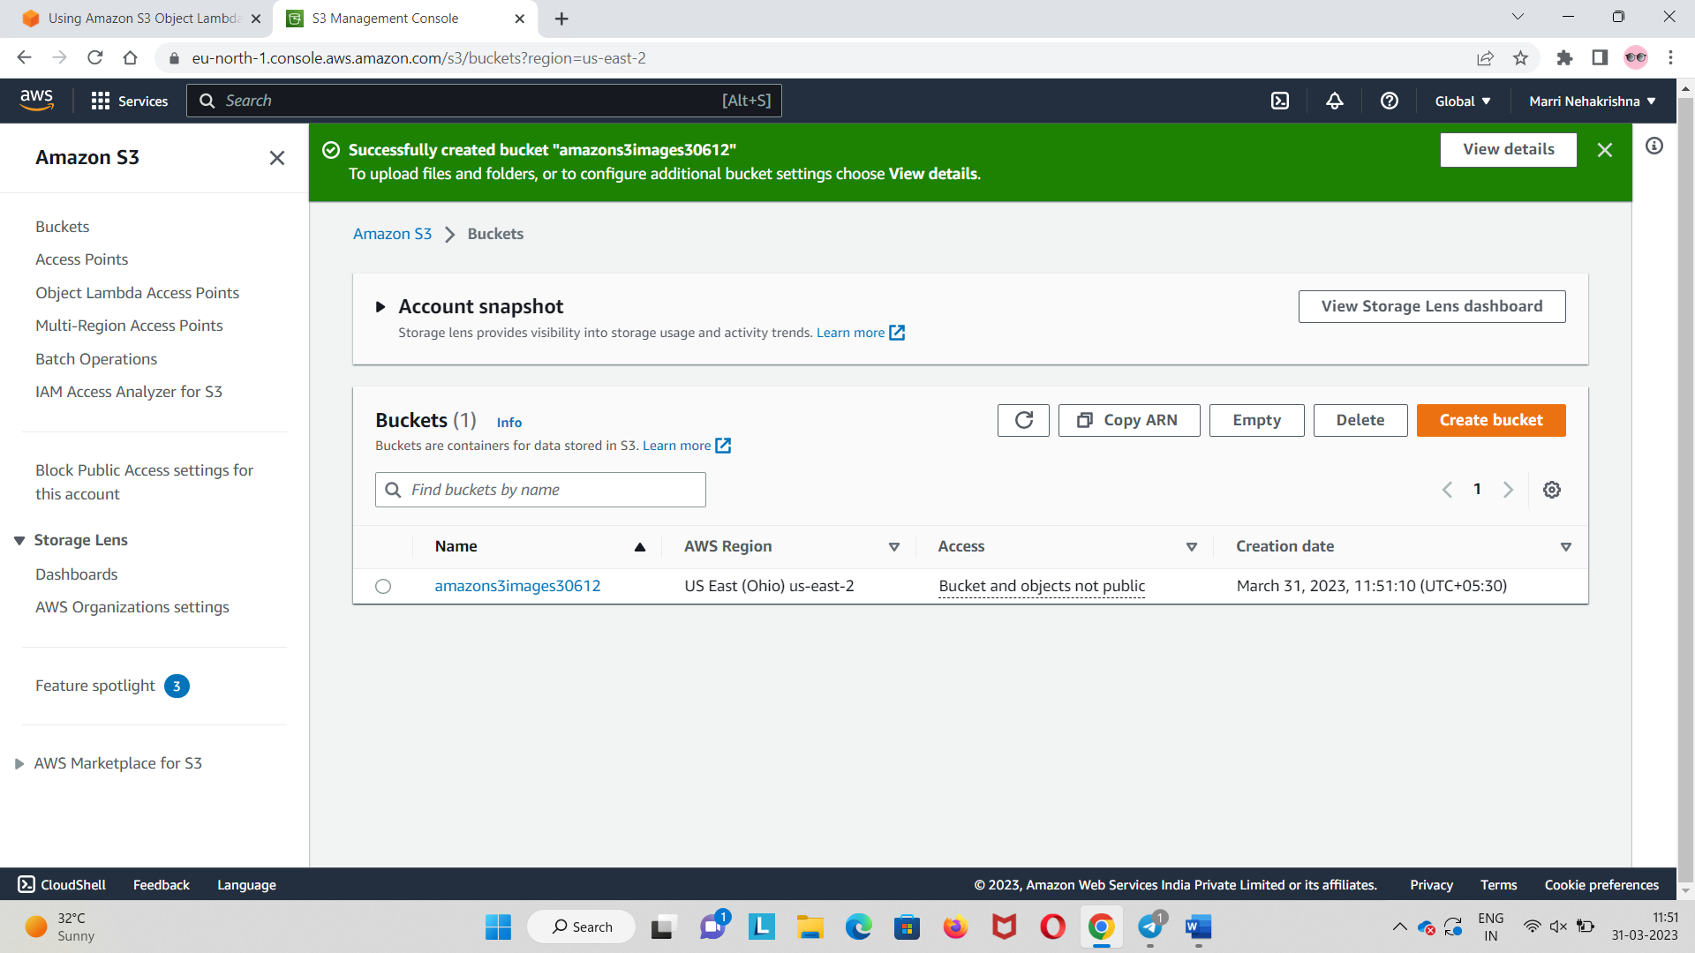
Step 1: Create an Amazon S3 bucket

Slide 6
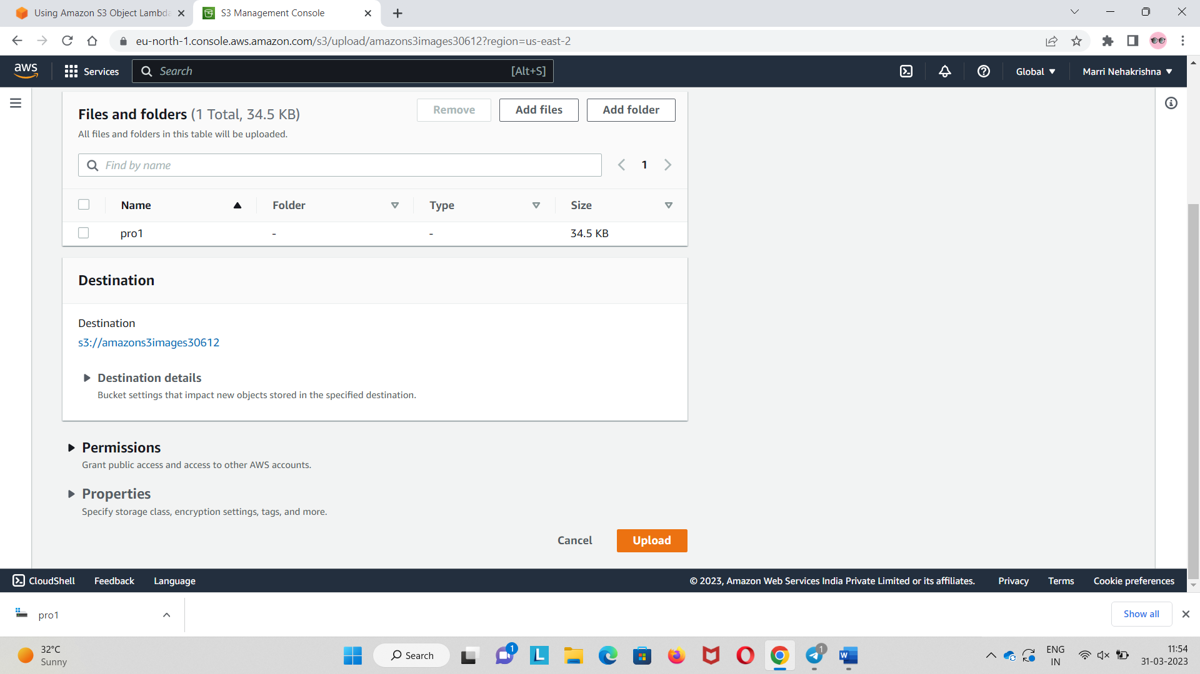
Step 2: Upload an object

Slide 7
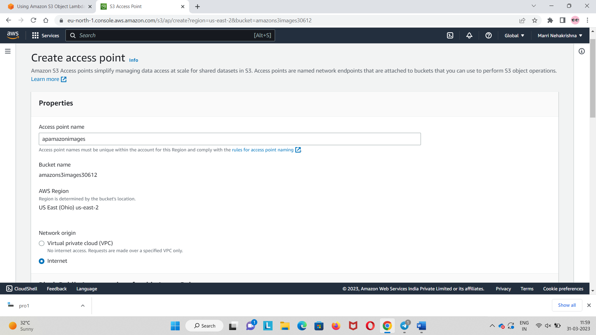
Step 3: Create an S3 Access Point

Slide 8
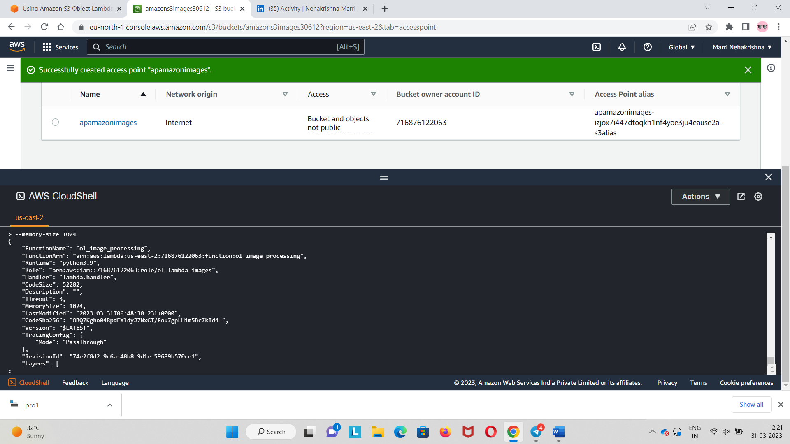
Step 4: Create the Lambda function

Slide 9
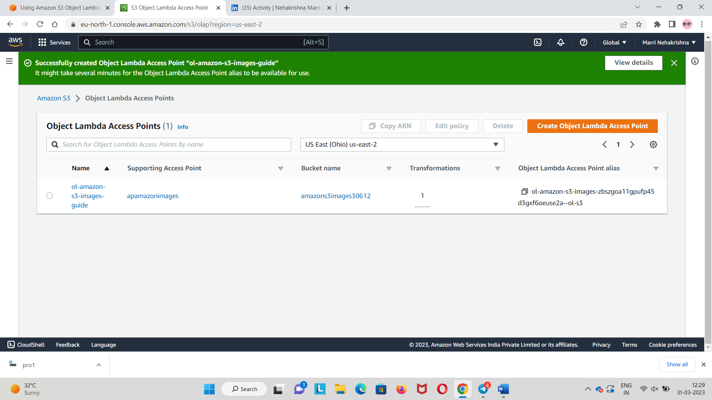
Step 5: Create an S3 Object Lambda Access Point

Slide 10
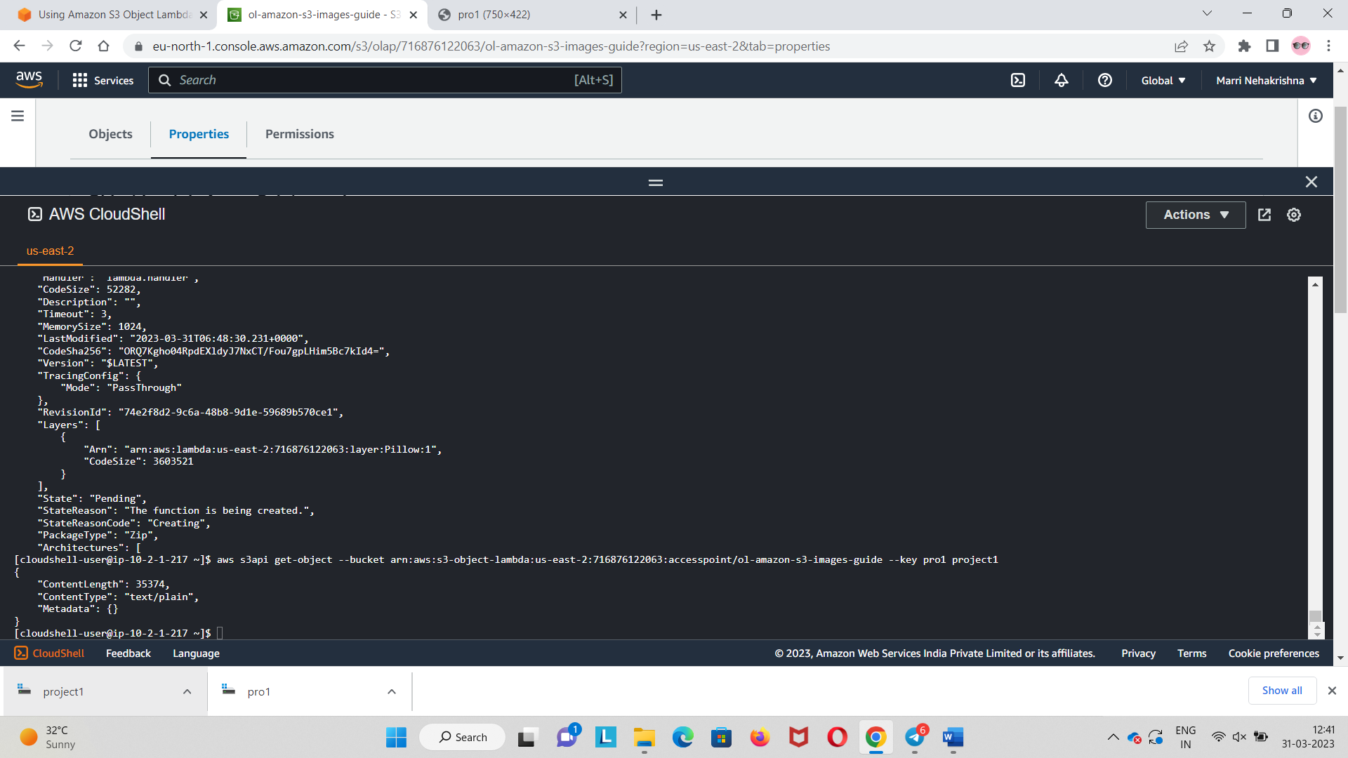
Step 6: Download images from the S3 Object Lambda Access Point

Slide 11

Downloaded File

Slide 12
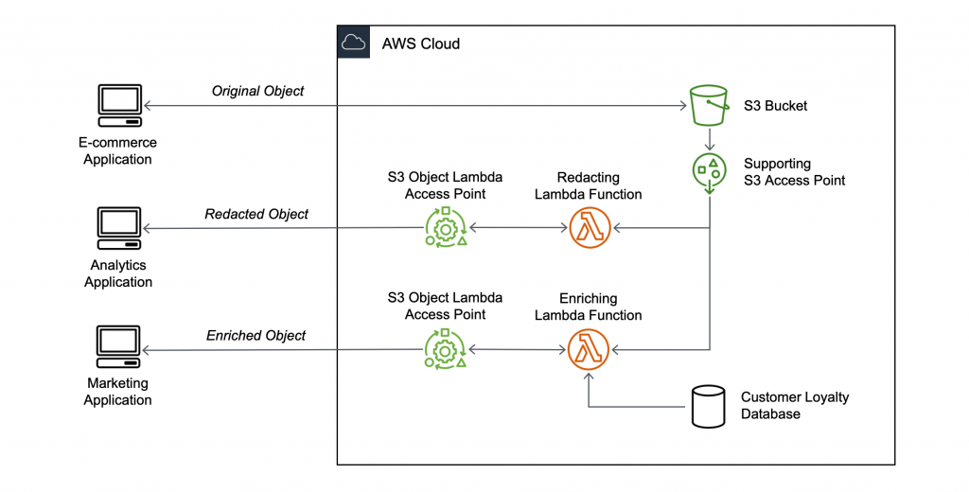
Transforming data for your application with S3 Object Lambda

Slide 13
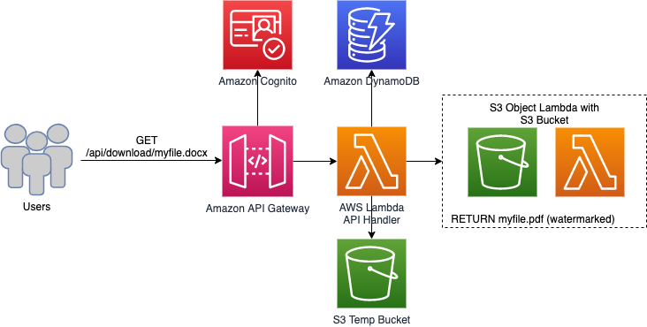
Convert and Watermark Documents Automatically with Amazon S3 Object Lambda

Slide 14
CONCLUSION
I have learned how to use Amazon S3 Object Lambda to dynamically add a watermark to an image as it is retrieved, delivering the processed image back to the requesting client. we can customize the Lambda function for our use case to modify the data returned by S3 GET, HEAD, and LIST requests, with common use cases including customizing watermarks using caller-specific details, masking sensitive data, filtering certain rows of data, augmenting data with information from other databases, converting data formats, and much more.

